Slide 1
CS 7900 Information Security
This lecture slide is mainly based on the power point slides by Professor Lawrie Brown.
CS7900, Meilin Liu
Notes:
Zili Shao

Slide 2
Access Control
Two parts to access control
Authentication: Are you who you say you are?
  Determine whether access is allowed
  Authenticate human to machine
  Or authenticate machine to machine
Authorization: Are you allowed to do that?
  Once you have access, what can you do?
  Enforces limits on actions
Note: “access control” often used as synonym for authorization
CS7900, Meilin Liu

Slide 3
Authentication: Are You Who You Say You Are?
How to authenticate human a machine?
Can be based on…
  Something you know
    For example, a password
  Something you have
    For example, a smartcard
  Something you are
    For example, your fingerprint
CS7900, Meilin Liu

Slide 4
Something You Know
Passwords
Lots of things act as passwords!
  PIN
  Social security number
  Mother’s maiden name
  Date of birth
  Name of your pet, etc.
CS7900, Meilin Liu

Slide 5
Trouble with Passwords
“Passwords are one of the biggest practical problems facing security engineers today.”
“Humans are incapable of securely storing high-quality cryptographic keys, and they have unacceptable speed and accuracy when performing cryptographic operations. (They are also large, expensive to maintain, difficult to manage, and they pollute the environment. It is astonishing that these devices continue to be manufactured and deployed.)”
CS7900, Meilin Liu

Slide 6
Why Passwords?
Why is “something you know” more popular than “something you have” and “something you are”?
Cost: passwords are free
Convenience: easier for admin to reset pwd than to issue a new thumb
CS7900, Meilin Liu

Slide 7
Keys vs Passwords
Crypto keys
Spse key is 64 bits
Then 2⁶⁴ keys
Choose key at random…
…then attacker must try about 2⁶³ keys
Passwords
Spse passwords are 8 characters, and 256 different characters
Then 256⁸ = 2⁶⁴ pwds
Users do not select passwords at random
Attacker has far less than 2⁶³ pwds to try (dictionary attack)
CS7900, Meilin Liu

Slide 8
Good and Bad Passwords
Bad passwords
  frank
  Fido
  password
  4444
  Pikachu
  102560
  AustinStamp
Good Passwords?
  jfIej,43j-EmmL+y
  09864376537263
  P0kem0N
  FSa7Yago
  0nceuP0nAt1m8
  PokeGCTall150
CS7900, Meilin Liu

Slide 9
Password Experiment
Three groups of users ⎯ each group advised to select passwords as follows
  Group A: At least 6 chars, 1 non-letter
  Group B: Password based on passphrase
  Group C: 8 random characters
Results
  Group A: About 30% of pwds easy to crack
  Group B: About 10% cracked
    Passwords easy to remember
  Group C: About 10% cracked
    Passwords hard to remember
winner →
CS7900, Meilin Liu

Slide 10
Password Experiment
User compliance hard to achieve
In each case, 1/3rd did not comply
  And about 1/3rd of those easy to crack!
Assigned passwords sometimes best
If passwords not assigned, best advice is…
  Choose passwords based on passphrase
  Use pwd cracking tool to test for weak pwds
Require periodic password changes?
CS7900, Meilin Liu

Slide 11
Attacks on Passwords
Attacker could…
  Target one particular account
  Target any account on system
  Target any account on any system
  Attempt denial of service (DoS) attack
Common attack path
  Outsider → normal user → administrator
  May only require one weak password!
CS7900, Meilin Liu

Slide 12
Password Retry
Suppose system locks after 3 bad passwords. How long should it lock?
  5 seconds
  5 minutes
  Until SA restores service
What are +’s and -’s of each?
CS7900, Meilin Liu

Slide 13
Password File?
Bad idea to store passwords in a file
But we need to verify passwords
Cryptographic solution: hash the pwd
  Store y = h(password)
  Can verify entered password by hashing
  If Trudy obtains “password file,” she does not obtain passwords
But Trudy can try a forward search
  Guess x and check whether y = h(x)
CS7900, Meilin Liu

Slide 14


Password File?
Account | Hash(Password)
David | kadd0d9fdas
John | jdssoisdfxdfe
…… | ……
Account, Hash(Password)
Password file
Account + Password

Slide 15
Dictionary Attack
Trudy pre-computes h(x) for all x in a dictionary of common passwords
Suppose Trudy gets access to password file containing hashed passwords
  She only needs to compare hashes to her pre-computed dictionary
  After one-time work, actual attack is trivial
Can we prevent this attack? Or at least make attacker’s job more difficult?
CS7900, Meilin Liu

Slide 16
Salt
Hash password with salt
Choose random salt s and compute
y = h(password, s)
and store (s,y) in the password file
Note: The salt s is not secret
Easy to verify salted password
But Trudy must re-compute dictionary hashes for each user
  Lots more work for Trudy!
CS7900, Meilin Liu

Slide 17
Salt
Hash + Salt
Acct | salt | Hash(pwd, salt)
David | 09182 | kadd0d9fdas
John | 23213 | jdssoisdfxdfe
…… | …… | ……
Account, Hash(Password, Salt)
Password file
Account + Password

Slide 18
Password Cracking:
Do the Math
Assumptions:
Pwds are 8 chars, 128 choices per character
  Then 128⁸ = 2⁵⁶ possible passwords
There is a password file with 2¹⁰ pwds
Attacker has dictionary of 2²⁰ common pwds
Probability of 1/4 that a pwd is in dictionary
Work is measured by number of hashes
CS7900, Meilin Liu

Slide 19
Password Cracking: Case I
Attack 1 password without dictionary
  Must try 2⁵⁶/2 = 2⁵⁵ on average
  Like exhaustive key search
Does salt help in this case?
CS7900, Meilin Liu

Slide 20
Password Cracking: Case II
Attack 1 password with dictionary
With salt
  Expected work: 1/4 (2¹⁹) + 3/4 (2⁵⁵) = 2^{54.6}
  In practice, try all pwds in dictionary…
  …then work is at most 2²⁰ and probability of success is 1/4
What if no salt is used?
  One-time work to compute dictionary: 2²⁰
  Expected work still same order as above
  But with precomputed dictionary hashes, the “in practice” attack is free…
CS7900, Meilin Liu

Slide 21
Password Cracking: Case III
Any of 1024 pwds in file, without dictionary
  Assume all 2¹⁰ passwords are distinct
  Need 2⁵⁵ comparisons before expect to find pwd
If no salt is used
  Each computed hash yields 2¹⁰ comparisons
  So expected work (hashes) is 2⁵⁵/2¹⁰ = 2⁴⁵
If salt is used
  Expected work is 2⁵⁵
  Each comparison requires a hash computation
CS7900, Meilin Liu
Notes:
Picture would be useful here

Slide 22
Password Cracking: Case IV
Any of 1024 pwds in file, with dictionary
  Prob. one or more pwd in dict.: 1 – (3/4)¹⁰²⁴ = 1
  So, we ignore case where no pwd is in dictionary
If salt is used, expected work less than 2²²
  See book, or slide notes for details
  Approximate work: size of dict. / probability
What if no salt is used?
  If dictionary hashes not precomputed, work is about 2¹⁹/2¹⁰ = 2⁹
CS7900, Meilin Liu
Notes:
Calculation for salted case:
Number the passwords in file, pwd1, pwd2, …,pwd1024
Consider checking each pwd in turn. The probability pwd1 is in the dictionary is 1/4 and, if so, expected work (no. of hashes) is 2^19. If pwd1 is not in dictionary but pwd2 is, we do 2^20 hashes (for pwd1) plus an expected 2^19 hashes for pwd2 and so on. We find the expected work factor is
(1/4)*(2^19) + (3/4)*((1/4)*(2^20+2^19) + (3/4)*((1/4)*(2*2^20+2^19)+…+(3/4)((1/4)(1023*2^20+2^19)))…) < 2^22

Slide 23
Other Password Issues
Too many passwords to remember
  Results in password reuse
  Why is this a problem?
Who suffers from bad password?
  Login password vs ATM PIN
Failure to change default passwords
Social engineering
Error logs may contain “almost” passwords
Bugs, keystroke logging, spyware, etc.
CS7900, Meilin Liu

Slide 24
Passwords
The bottom line…
Password cracking is too easy
  One weak password may break security
  Users choose bad passwords
  Social engineering attacks, etc.
Trudy has (almost) all of the advantages
All of the math favors bad guys
Passwords are a BIG security problem
  And will continue to be a big problem
CS7900, Meilin Liu

Slide 25
Password Cracking Tools
Popular password cracking tools
  Password Crackers
  Password Portal
  L0phtCrack and LC4 (Windows)
  John the Ripper (Unix)
Admins should use these tools to test for weak passwords since attackers will
Good articles on password cracking
  Passwords - Conerstone of Computer Security
  Passwords revealed by sweet deal
CS7900, Meilin Liu

Slide 26
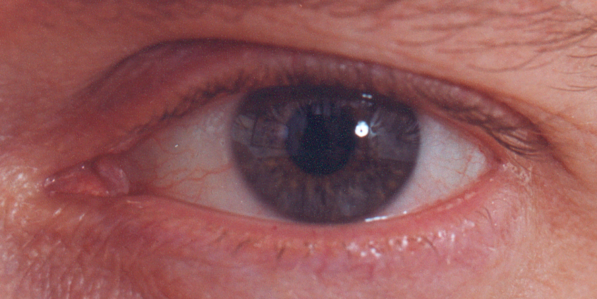
Biometrics
CS7900, Meilin Liu

Slide 27
Something You Are
Biometric
  “You are your key” ⎯ Schneier
Examples
  Fingerprint
  Handwritten signature
  Facial recognition
  Speech recognition
  Gait (walking) recognition
  “Digital doggie” (odor recognition)
  Many more!
Are
Know
Have
CS7900, Meilin Liu

Slide 28
Why Biometrics?
More secure replacement for passwords
Cheap and reliable biometrics needed
  Today, an active area of research
Biometrics are used in security today
  Thumbprint mouse
  Palm print for secure entry
  Fingerprint to unlock car door, etc.
But biometrics not too popular
  Has not lived up to its promise (yet?)
CS7900, Meilin Liu

Slide 29
Ideal Biometric
Universal ⎯ applies to (almost) everyone
  In reality, no biometric applies to everyone
Distinguishing ⎯ distinguish with certainty
  In reality, cannot hope for 100% certainty
Permanent ⎯ physical characteristic being measured never changes
  In reality, OK if it to remains valid for long time
Collectable ⎯ easy to collect required data
  Depends on whether subjects are cooperative
Also, safe, user-friendly, etc., etc.
CS7900, Meilin Liu

Slide 30
Biometric Modes
Identification ⎯ Who goes there?
  Compare one-to-many
  Example: The FBI fingerprint database
Authentication ⎯ Are you who you say you are?
  Compare one-to-one
  Example: Thumbprint mouse
Identification problem is more difficult
  More “random” matches since more comparisons
We are interested in authentication
CS7900, Meilin Liu

Slide 31
Enrollment vs Recognition
Enrollment phase
  Subject’s biometric info put into database
  Must carefully measure the required info
  OK if slow and repeated measurement needed
  Must be very precise
  May be weak point of many biometric
Recognition phase
  Biometric detection, when used in practice
  Must be quick and simple
  But must be reasonably accurate
CS7900, Meilin Liu

Slide 32
Biometric Errors
Fraud rate versus insult rate
  Fraud ⎯ Trudy mis-authenticated as Alice
  Insult ⎯ Alice not authenticated as Alice
For any biometric, can decrease fraud or insult, but other one will increase
For example
  99% voiceprint match ⇒ low fraud, high insult
  30% voiceprint match ⇒ high fraud, low insult
Equal error rate: rate where fraud == insult
  A way to compare different biometrics
CS7900, Meilin Liu

Slide 33
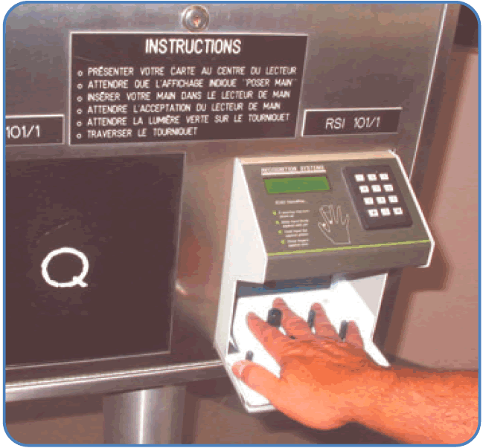
Hand Geometry
A popular biometric
Measures shape of hand
  Width of hand, fingers
  Length of fingers, etc.
Human hands not unique
Hand geometry sufficient for many situations
OK for authentication
CS7900, Meilin Liu

Slide 34
Hand Geometry
Advantages
  Quick ⎯ 1 minute for enrollment, 5 seconds for recognition
  Hands are symmetric ⎯ so what?
Disadvantages
  Cannot use on very young or very old
  Relatively high equal error rate
CS7900, Meilin Liu

Slide 35
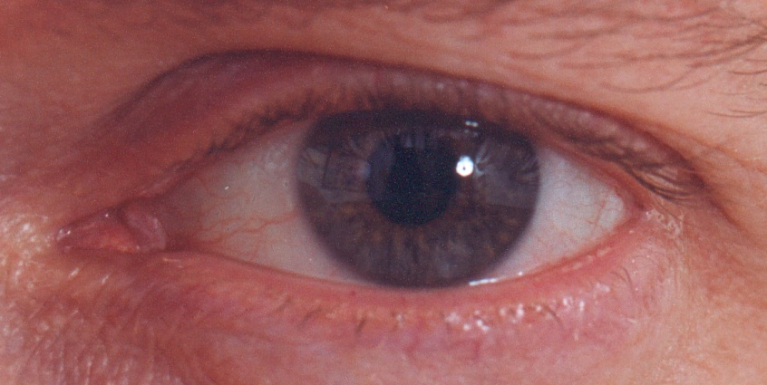
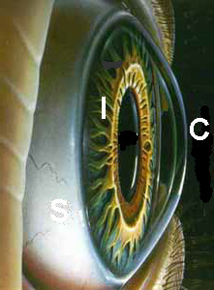

Iris Patterns
Iris pattern development is “chaotic”
Little or no genetic influence
Different even for identical twins
Pattern is stable through lifetime
CS7900, Meilin Liu

Slide 36
Equal Error Rate Comparison
Equal error rate (EER): fraud == insult rate
Fingerprint biometric has EER of about 5%
Hand geometry has EER of about 10⁻³
In theory, iris scan has EER of about 10⁻⁶
  But in practice, may be hard to achieve
  Enrollment phase must be extremely accurate
Most biometrics much worse than fingerprint!
Biometrics useful for authentication…
  …but identification biometrics almost useless today
CS7900, Meilin Liu

Slide 37
Biometrics: The Bottom Line
Biometrics are hard to forge
But attacker could
  Steal Alice’s thumb
  Photocopy Bob’s fingerprint, eye, etc.
  Subvert software, database, “trusted path” …
And how to revoke a “broken” biometric?
Biometrics are not foolproof
Biometric use is limited today
That should change in the (near?) future
CS7900, Meilin Liu

Slide 38
Something You Have
Something in your possession
Examples include following…
  Car key
  Laptop computer (or MAC address)
  Password generator (next)
  ATM card, smartcard, etc.
CS7900, Meilin Liu

Slide 39
2-factor Authentication
Requires any 2 out of 3 of
  Something you know
  Something you have
  Something you are
Examples
  ATM: Card and PIN
  Credit card: Card and signature
  Password generator: Device and PIN
  Smartcard with password/PIN
CS7900, Meilin Liu

